Slide 1
Code Performance with
Benchmark Numbers
Romnick Mamisay
IntegrityNet Solutions & Services | Software Developer

Slide 2
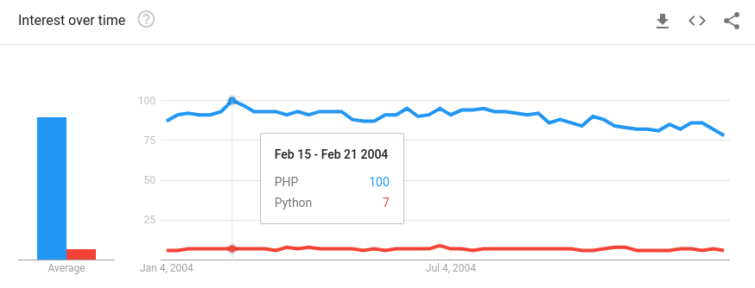
PHP and Python in 2004

Slide 3
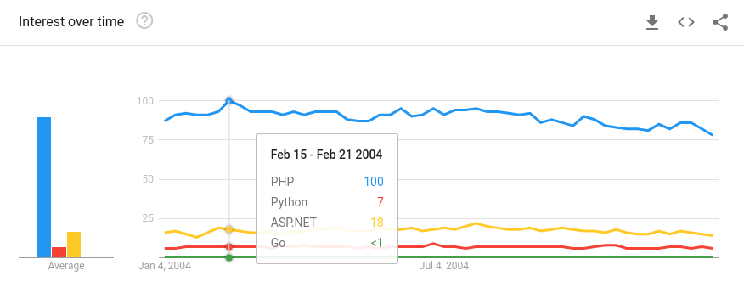
Programming languages in 2004

Slide 4
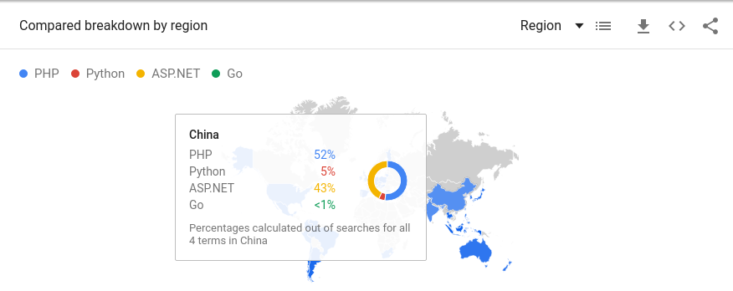

ASP.NET in China and India

Slide 5
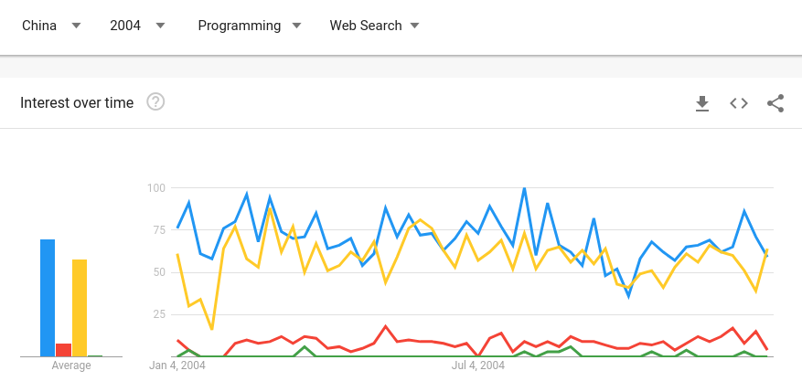

Programming Trend in China

Slide 6
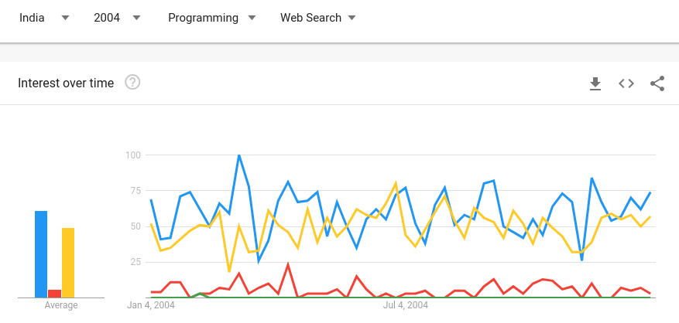
Programming Trend in India

Slide 7
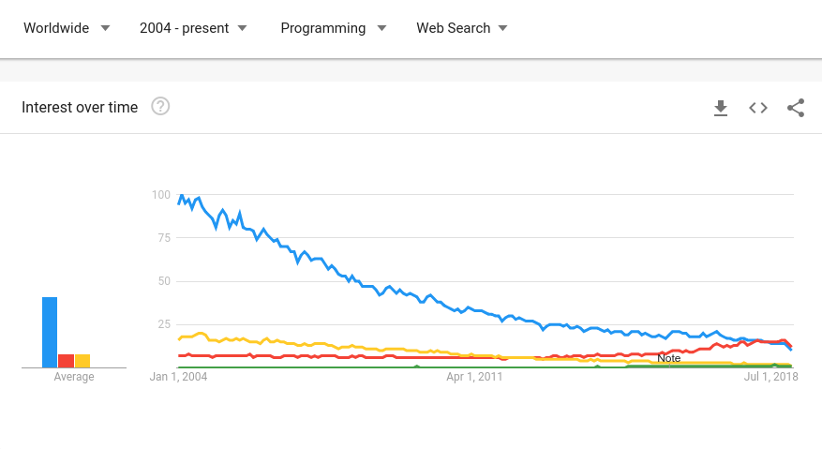
2004 - present

Slide 8
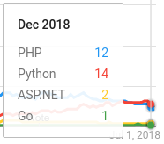
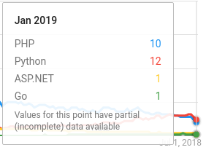
Percentage of Popularity by Month
PHP – 41%
Python – 48%
ASP.NET – 7%
Go – 4%
PHP – 42%
Python – 50%
ASP.NET – 4%
Go – 4%

Slide 9
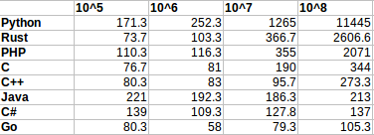
Results in Windows
Go vs. Python = 109x faster
Go vs. PHP = 20x faster
Go vs. C = 3x faster

Slide 10
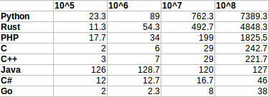
Results in Linux
Go vs. Python = 194x faster
Go vs. PHP = 48x faster
Go vs. C = 6x faster

Slide 11
References
Kevin Baas (June 9, 2016). Is Linux faster than Windows? To be precise, is a program run in Linux faster than that of Windows, given the same hardware specification? Retrieved from https://www.quora.com/Is-Linux-faster-than-Windows-To-be-precise-is-a-program-run-in-Linux-faster-than-that-of-Windows-given-the-same-hardware-specification
admin (Jan. 17, 2017). Surprising Facts Why Python is gaining more popularity among Developers. Retrieved from https://www.zarantech.com/blog/surprising-facts-python-gaining-popularity-among-developers/
Jamsheer K. (April 24, 2017). 15 Top Reasons to Choose PHP over ASP.NET. Retrieved from https://acodez.in/choose-php-over-asp-net/#PHP_or_ASPNet
Samuel Jones (March 2, 2018). The pros and cons of programming in Go. Retrieved from https://willowtreeapps.com/ideas/the-pros-and-cons-of-programming-in-go
Matt W (November 27, 2018). What is ASP.NET and Why Should I Use It? Retrieved from https://www.wakefly.com/blog/what-is-asp-net-and-why-should-i-use-it/
Sunil Goyal (December 5, 2018). 10 Reasons Why Python Scores Over PHP for Web Development. Retrieved from https://www.netsolutions.com/insights/10-reasons-why-python-scores-over-php-for-web-development/

Slide 12
Thank you!

